Slide 1
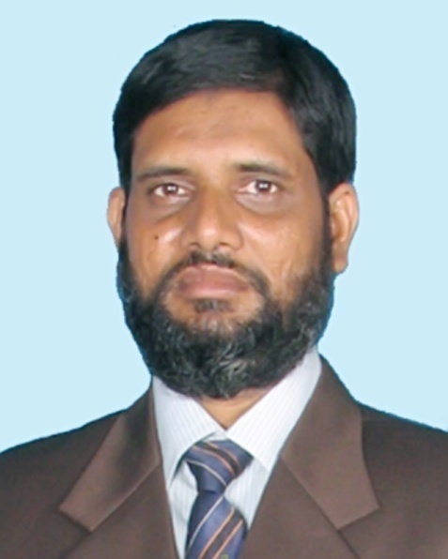
Teacher introduction
Noor-e-Alam Jhilu
(M.A in English B.Ed)
Senior Assistant Teacher (English)
Ikrashi Adarsha high school
Mobile: 01779543648
Email: noorealamjhilu@yahoo.com

Slide 2
WELCOME
To
English class

Slide 3
Subject :-English 2nd paper
Class:-Nine
Unite:-Four
Lesson:-2
Time:40min

Slide 4
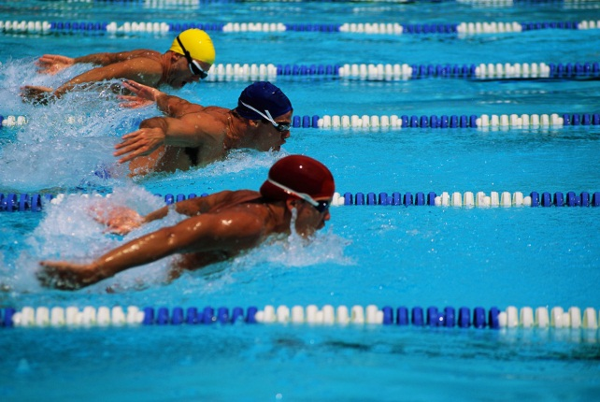
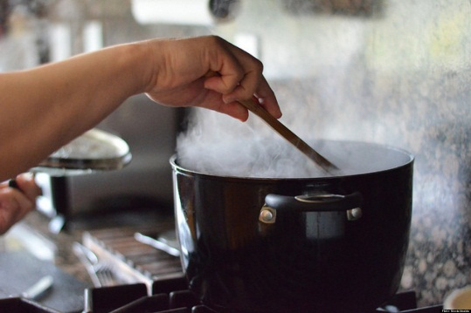
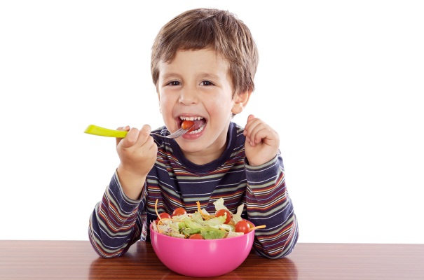
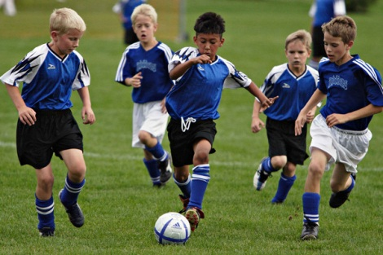
Pre-Knowledge verification
Cooking
Swimming
?
Eating
Playing

Slide 5
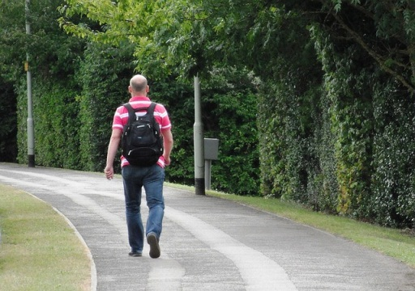
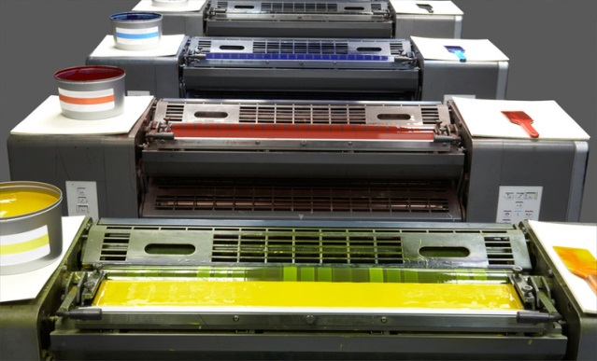
Pre-knowledge Verification
Printing
?
?
Walking
?
?
Talking
Rising

Slide 6
Today lesson
Gerund and
Present participle

Slide 8
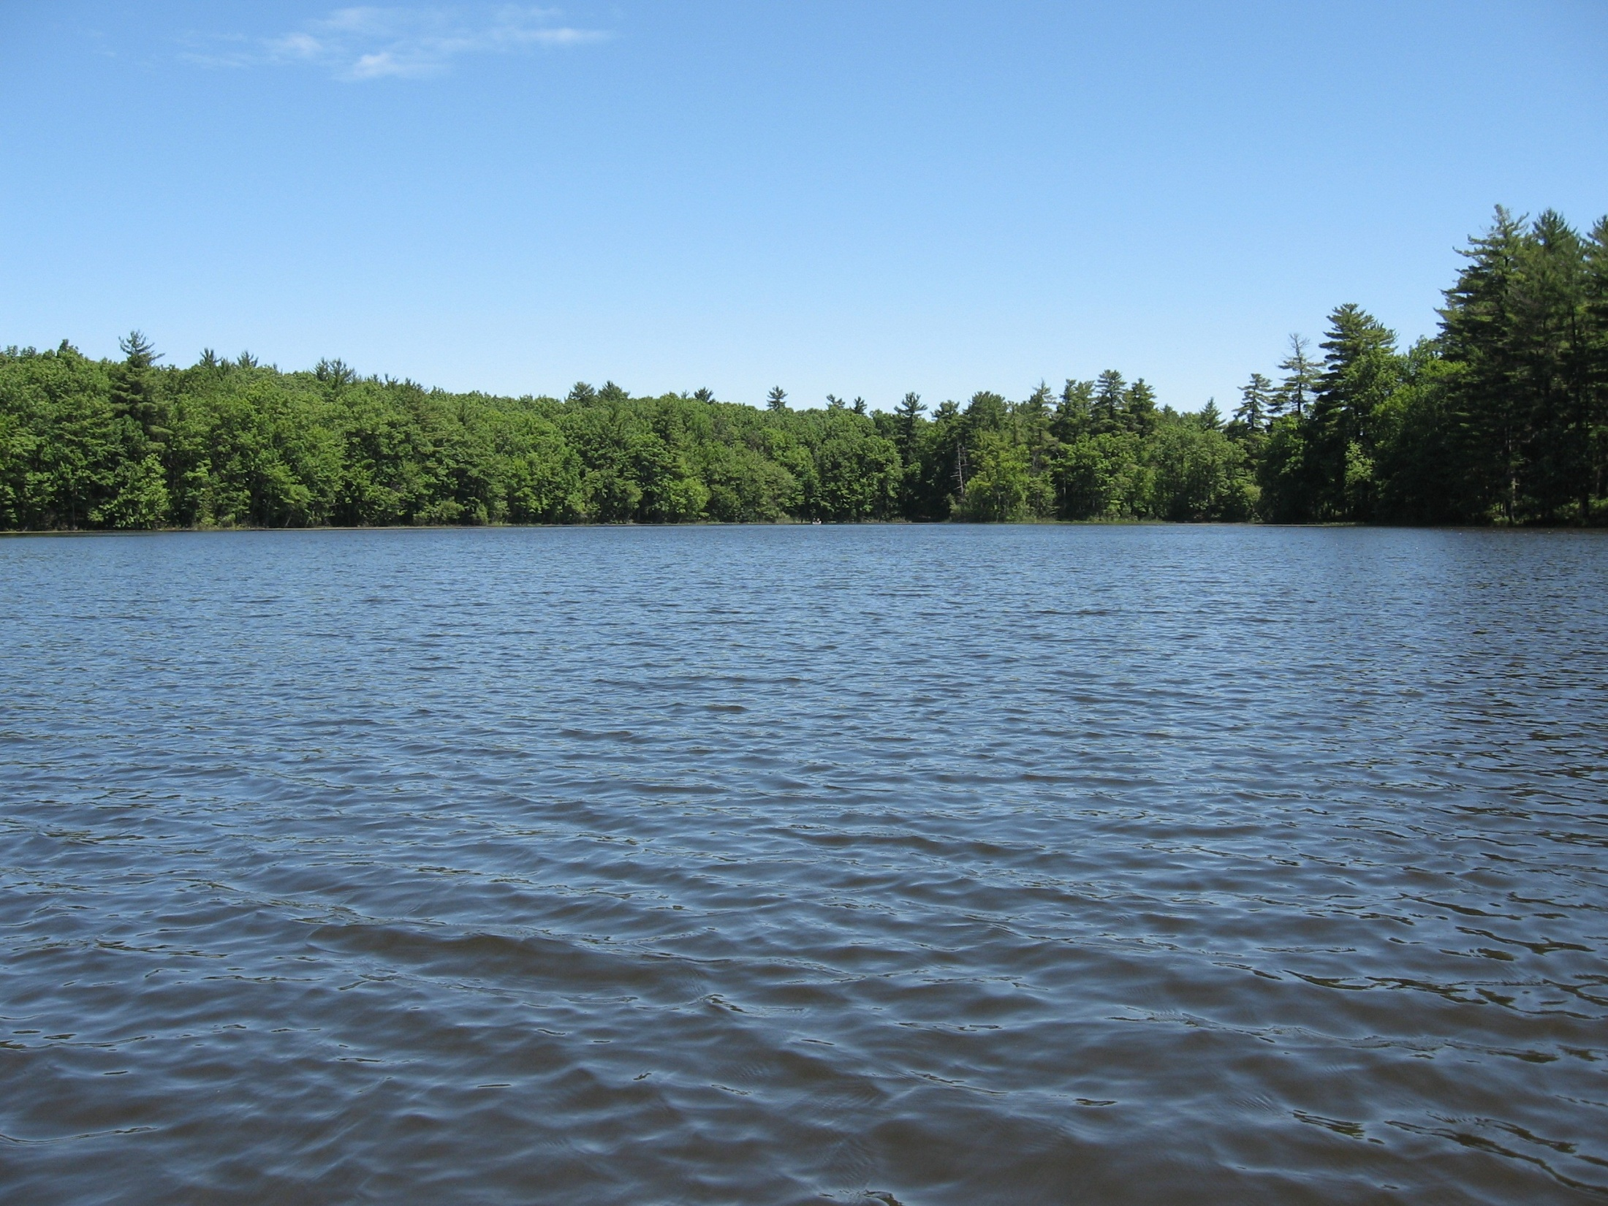
Objectives:
By the end of the lesson students will have
practiced Gerund.
differentiated gerund-present participle
Made the sentences using gerund.

Slide 9
Read the Sentence carefully
Learning
is a continuous process
Walking
is good for health
Reading
books is a good habit.
Stop
writing
He learns
drawing

Slide 10
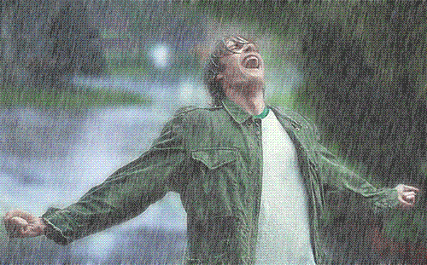
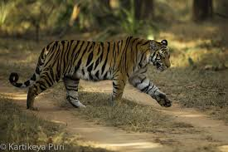
Look! There are difference between gerund and present participle.
Juggling is a good exercise.
gerund
He went out for enjoying rain.
gerund
I saw a tiger going away.
Present participle

Slide 11
Find out Gerund and present participle
Present participle
Gerund
1. My fibrate hobby is gardening . After getting up from bed, I go to my garden every morning. Wearing old dress and being ready I work there for an hour. Then Taking a bath, having break fast and wearing uniform I go to school for learning. In this time I see many students going to school.
Gerunds are words that are formed with verbs but act as nouns.

Slide 12
Present participle
EXAMPLES
I heard someone singing.
He saw his friend walking along the road.
I can smell something burning!
I watched the birds flying away.
A present participle is a verb form (or verbal)--made by adding -ing to the base--that often functions as an adjective.

Slide 13
Group work
My fibrate hobby is………………………
We need safe…………………water .
……. is a good exercise.
……………books is a good habit .

Slide 14
Follow the correct answer
Gardening
Drinking
playing
reading

Slide 15
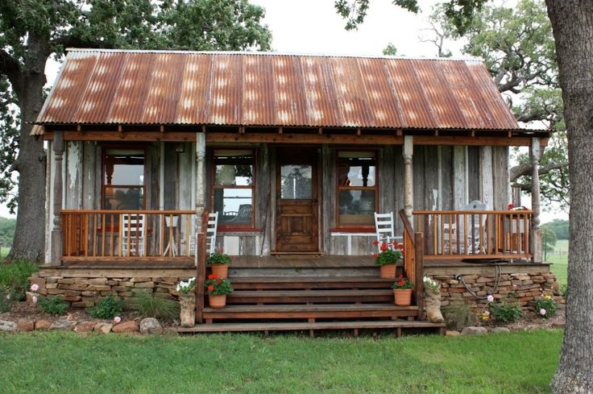
Home work
You will make 5 sentences using of gerund

